Slide 1

Resilient Asymptotic Consensus in Robust Networks
IEEE JOURNAL ON SELECTED AREAS IN COMMUNICATIONS 2013
——刘洪彬

Slide 2


Author
Health J. LeBlanc
Assistant Professor
Ohio Northern University
Multiagent System
Haotian Zhang
Doctoral Student
University of Waterloo
Complex Network & Fault-tolerant Control

Slide 3


Author
Xenofon Koutsoukos
Assistant Professor
Vanderbilt University
Cyber-physical Systems
Shreyas Sundaram
Assistant Professor
University of Waterloo
Analysis of Dynamics on Networks & Fault-tolerant Control

Slide 4

Introduction
Content
Problem Formulation
Consensus Algorithm
Resilient Consensus
Robust Network
Network Construction
Simulation Results

Slide 5

Introduction

Slide 6
Introduction
Reaching consensus according to a certain strategy
Quantities of interest must be calculated using only local information
Potential vulnerable points may exists in large-scale distributed system
Low complexity & Using only local information
Properties that allow normal nodes to compute an appropriate consensus value
Network Robustness

Slide 7
Problem Formulation

Slide 8
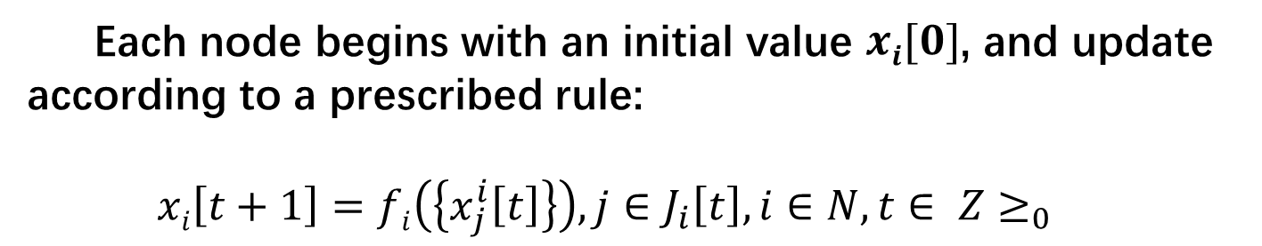
Update Model
Each node begins with an initial value $xi[0]$, and update according to a prescribed rule:
$$xi\left[t+1\right]=fi\left(\left\{x_{j}^{i}\left[t\right]\right\}\right), j∈J_{i}\left[t\right], i∈N, t∈ Z≥_{0}$$
In-neighbors for digraph, neighbors for undirected graph
Neighbors & node i
Normal nodes

Slide 9
Threat Model
Byzantine: send not the same value, apply some other function f.
Malicious: send the same value, apply some other function f.

Slide 10
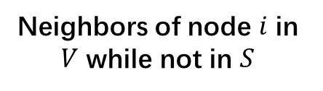
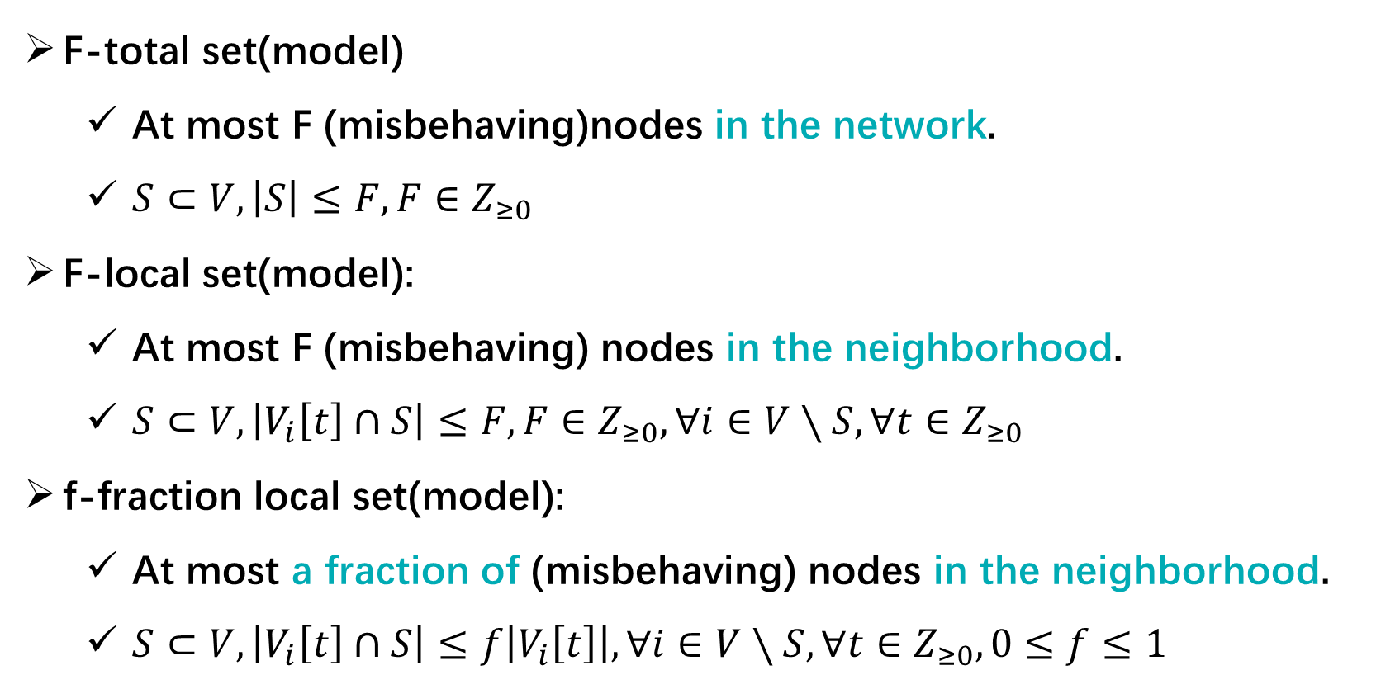
Scope of Threats
F-total set(model)
At most F (misbehaving)nodes in the network.
$S⊂V,\left|S\right|≤F, F∈Z_{≥0}$
F-local set(model):
At most F (misbehaving) nodes in the neighborhood.
$S⊂V,\left|V_{i}\left[t\right]∩S\right|≤F, F∈Z_{≥0},∀ⅈ∈V∖S,∀t∈Z_{≥0}$
f-fraction local set(model):
At most a fraction of (misbehaving) nodes in the neighborhood.
$S⊂V,\left|V_{i}\left[t\right]∩S\right|≤f\left|V_{i}\left[t\right]\right|, ∀ⅈ∈V∖S,∀t∈Z_{≥0},0≤f≤1$
Neighbors of node $ⅈ$ in $V$ while not in $S$

Slide 11
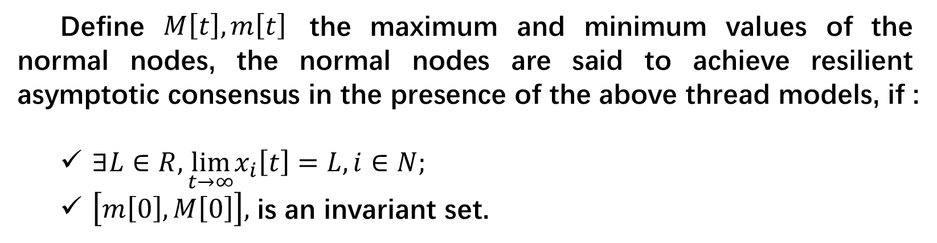
Resilient Asymptotic Consensus
Define $M\left[t\right],m\left[t\right]$ the maximum and minimum values of the normal nodes, the normal nodes are said to achieve resilient asymptotic consensus in the presence of the above thread models, if :
$∃L∈R,\lim_{t→∞}x_{i}\left[t\right]=L,i∈N;$
$\left[m\left[0\right],M\left[0\right]\right],$ is an invariant set.
agreement condition
safety condition
All normal nodes must converge to must lie within the range of initial values of the normal nodes.
validity condition

Slide 12
Consensus Algorithm

Slide 13
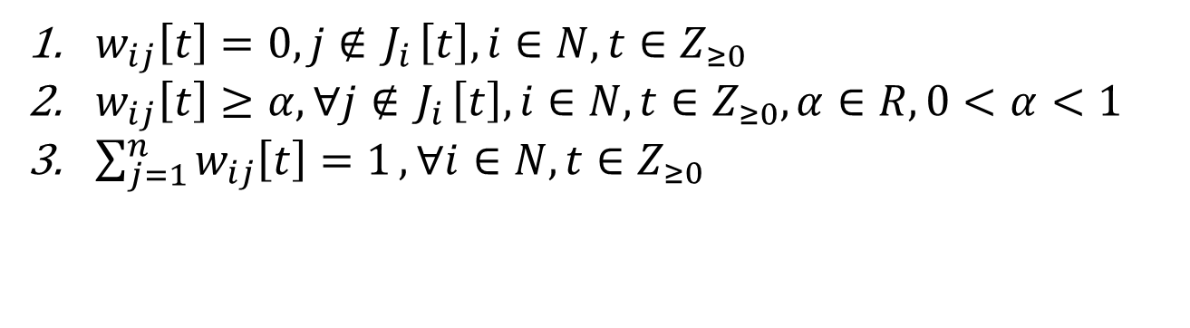

Linear Consensus Protocol
$$xi\left[t+1\right]=\sum_{j∈J_{i}[t]}{w_{ij}\left[t\right]x_{j}^{i}[t]}$$
$w_{ij}\left[t\right]=0, j∉{ J}_{i}\left[t\right],i∈N,t∈Z_{≥0}$
$w_{ij}\left[t\right]≥α, ∀j∉{ J}_{i}\left[t\right],i∈N,t∈Z_{≥0},α∈R, 0<$ $α<1$
$\sum_{j=1}^{n}{w_{ij}\left[t\right]=1}, ∀i∈N,t∈Z_{≥0}$

Slide 14
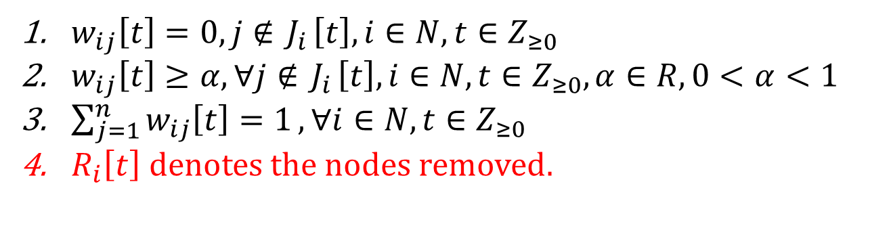

Weighted Mean Subsequence Reduced
Remove F values strictly larger or smaller than itself:
$$xi\left[t+1\right]=\sum_{j∈J_{i}[t]\backslash R_{i}\left[t\right]}{w_{ij}\left[t\right]x_{j}^{i}[t]}$$
$w_{ij}\left[t\right]=0, j∉{ J}_{i}\left[t\right],i∈N,t∈Z_{≥0}$
$w_{ij}\left[t\right]≥α, ∀j∉{ J}_{i}\left[t\right],i∈N,t∈Z_{≥0},α∈R, 0<$ $α<1$
$\sum_{j=1}^{n}{w_{ij}\left[t\right]=1}, ∀i∈N,t∈Z_{≥0}$
$R_{i}\left[t\right] denotes the nodes removed.$

Slide 15
Robust Network Topologies

Slide 16
Proposition 1
$$n,F∈Z_{>0},F≤\left\lfloor \frac{n}{2}\right\rfloor ,∃G,k=\left\lfloor \frac{n}{2}\right\rfloor +F−1$$
Can not achieve consensus using W-MSR with param. F.
1
5
1
2
6
2
3
7
8
8
4
Example of a 5-connected graph satisfying Prop. 1 with F = 2

Slide 17
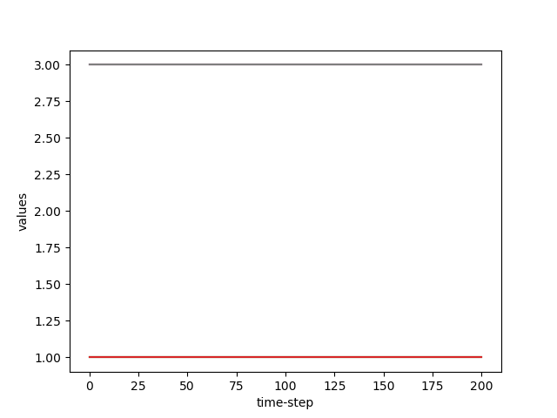
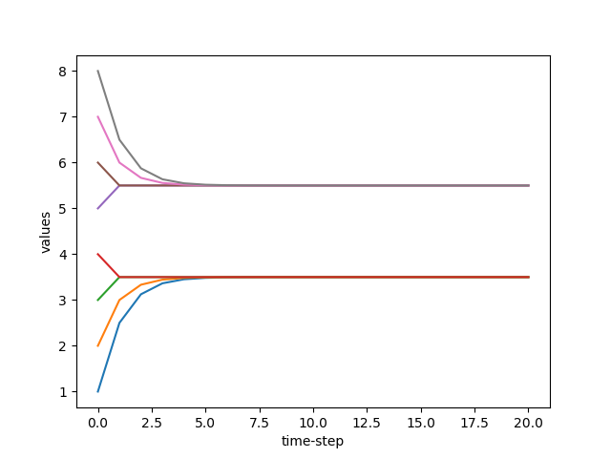
Proof
Stimulation of a 5-connected graph satisfying Prop. 1 with F = 2

Slide 18



f-fraction reachable set
r-reachable set
$$≥p\left|V_{i}\right|,0<p<1$$
$$Given D=(V,Σ),nonempty set S⊂V,∃ⅈ∈S,\left|V_{i}∖S\right|≥r,r∈Z>0$$
1
$$≥p\left|V_{i}\right|$$
2
…
$$≥r$$
S
3
4
An example of r-reachable set
f-fraction reachable set

Slide 19






r-robustness
f-fraction robustness
$$Given D=(V,Σ),any pair of nonempty set S_{1},S_{2}⊂V,S_{1}∩S_{2}=∅,S_{1} or S_{2} is r−reachable$$
$$f−fraction reachable$$
$$≥p\left|V_{i}\right|,0<p<1$$
1
$$≥r$$
2
…
$$D$$
$$S_{1}$$
5
$$S_{2}$$
3
6
4
7
…
An example of r-robustness
f-fraction robustness

Slide 20

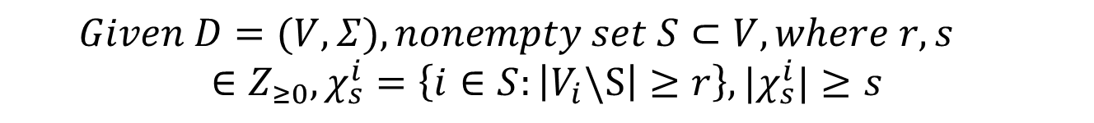



(r,s)-reachable set
$$Given D=(V,Σ),nonempty set S⊂V,where r,s∈Z_{≥0},χ_{s}^{i}=\left\{i∈S:\left|V_{i}\backslash S\right|≥r\right\},|χ_{s}^{i}|≥s$$
$$≥s$$
…
S
…
…
…
$$≥r$$
$$≥r$$
$$≥r$$
An example of (r,s)-reachable set

Slide 21
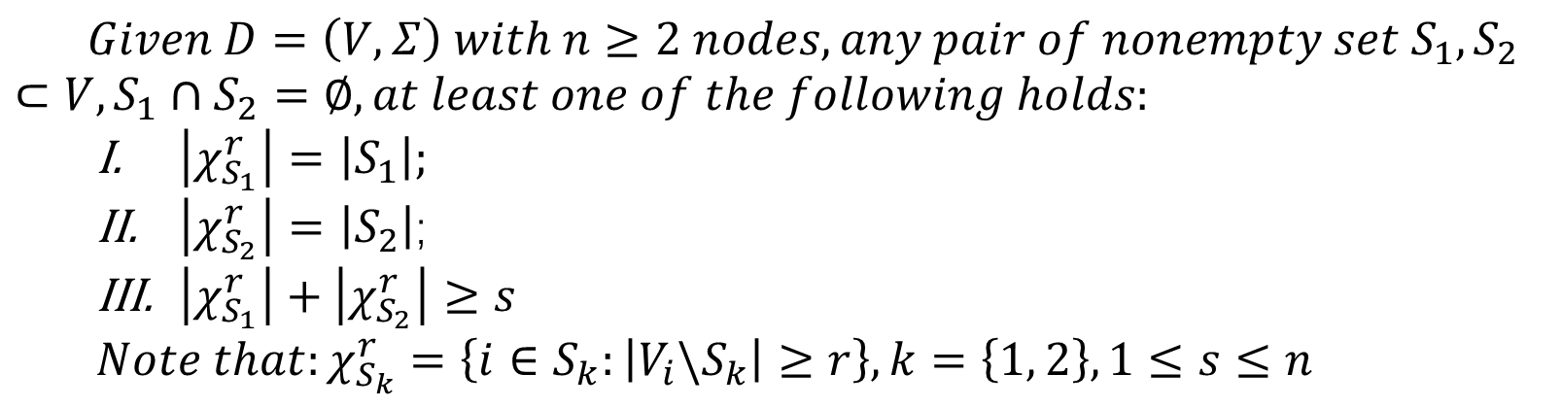
(r,s)-robustness
$$Given D=\left(V,Σ\right) with n≥2 nodes,any pair of nonempty set S_{1},S_{2}⊂V,S_{1}∩S_{2}=∅, at least one of the following holds:$$
$\left|χ_{S_{1}}^{r}\right|=\left|S_{1}\right|;$
$\left|χ_{S_{2}}^{r}\right|=\left|S_{2}\right|$;
$\left|χ_{S_{1}}^{r}\right|+\left|χ_{S_{2}}^{r}\right|≥s$
$$Note that:χ_{S_{k}}^{r}=\left\{i∈S_{k}:\left|V_{i}\backslash S_{k}\right|≥r\right\},k=\left\{1, 2\right\},1≤s≤n$$
2
5
8
12
1
3
6
9
11
13
4
7
10
14
Example of a (r,s)-robustness topology

Slide 22
Resilient Consensus Analysis

Slide 23

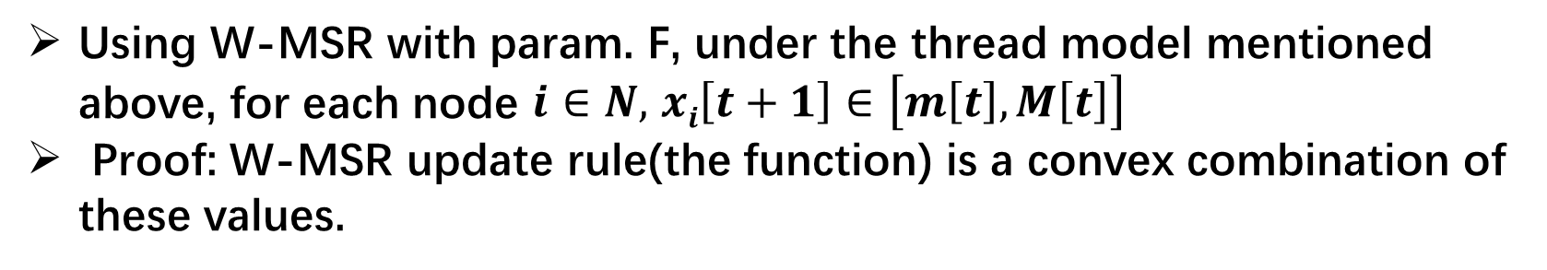
Lemma 1
Using W-MSR with param. F, under the thread model mentioned above, for each node $i∈N,$ $xi\left[t+1\right]∈\left[m\left[t\right],M\left[t\right]\right]$
Proof: W-MSR update rule(the function) is a convex combination of these values.
$$The convex conbination of x_{1},x_{2},…x_{n} is$$
$a_{1}x_{1}+a_{2}x_{2}+…{+a_{n}x_{n}∈[\min\left(x_{1},x_{2},…x_{n}\right),max⁡(x_{1},x_{2},…x_{n})]{,a}_{1}+a_{2}+…{+a_{n}=1}}$
$\left[m\left[t+1\right],M\left[t+1\right]\right]$ $⊂$ $\left[m\left[t\right],M\left[t\right]\right]$
safety condition

Slide 24
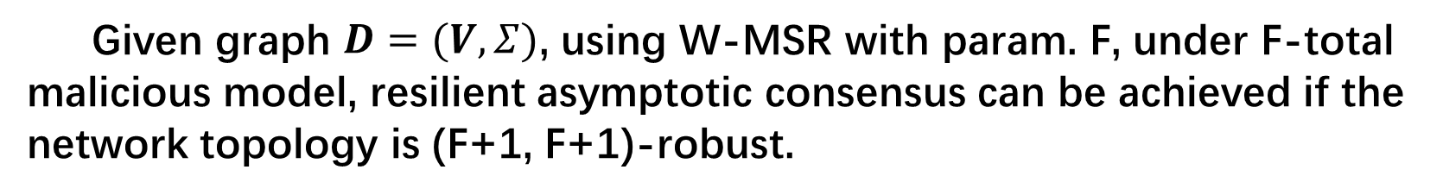
Theorem 1
Given graph $D=(V, Σ)$, using W-MSR with param. F, under F-total malicious model, resilient asymptotic consensus can be achieved if the network topology is (F+1, F+1)-robust.
agreement condition

Slide 25
Stimulation Results

Slide 26
Stimulations
0
1
1
1
0
0
1
2
1
1
0
1
1
1
Example of a (2,2)-robust topology

Slide 27
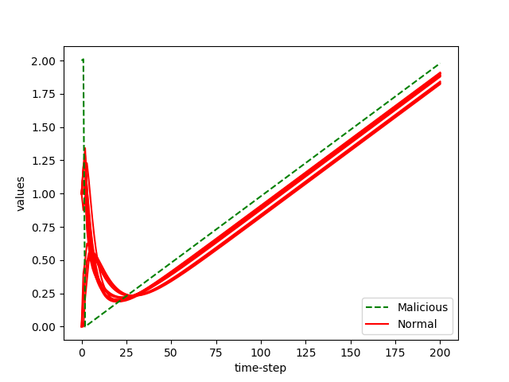
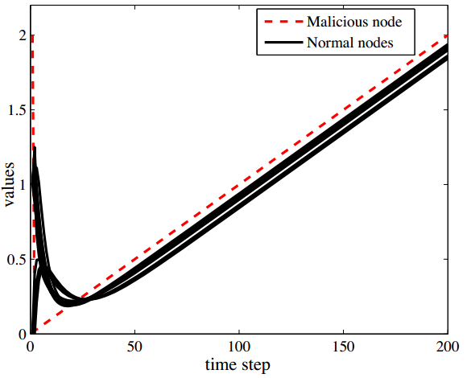
Stimulations
LCP

Slide 28
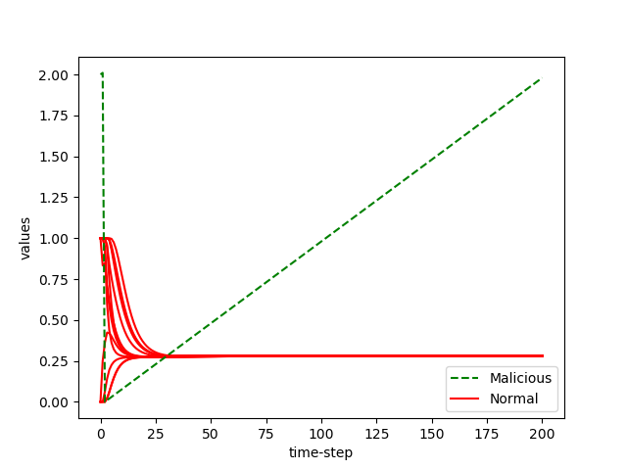
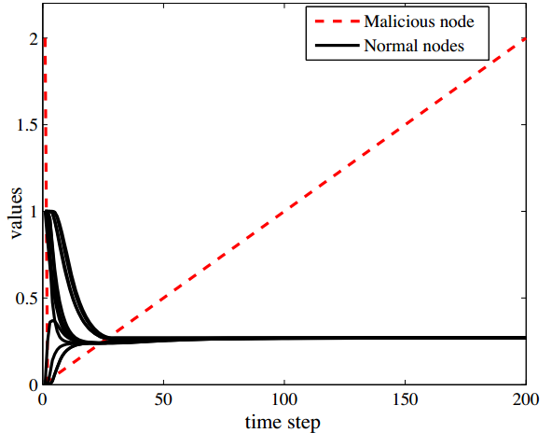
Stimulations
W-MSR

Slide 29
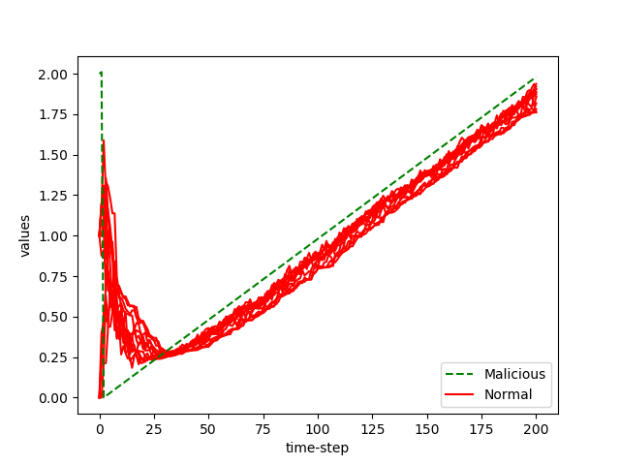
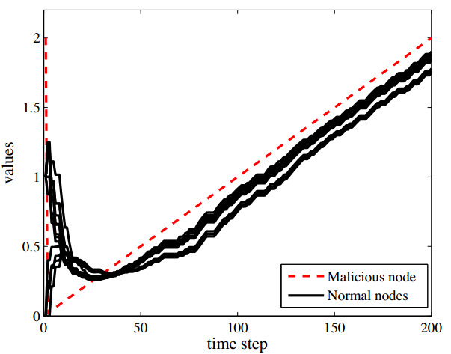
Stimulations
LCP with time-varying

Slide 30
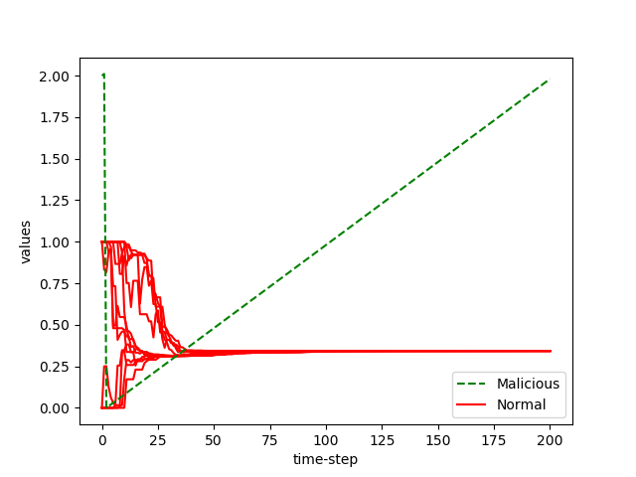
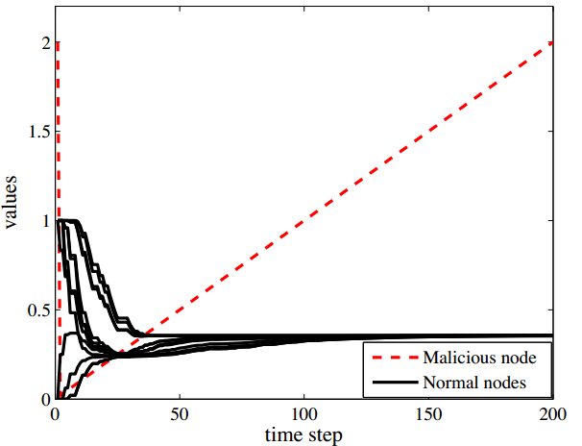
Stimulations
W-MSR with time-varying

Slide 31
Network Construction

Slide 32
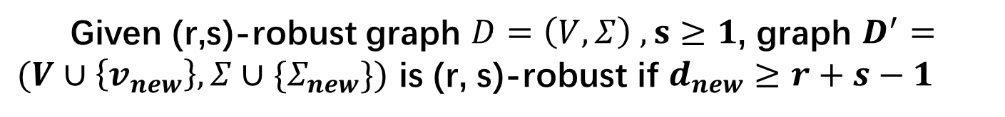
Theorem 2
Given (r,s)-robust graph $D=\left(V,Σ\right) ,s≥1$, graph $D^{′}=(V∪\left\{v_{new}\right\},Σ∪\{Σ_{new}\})$ is (r, s)-robust if $d_{new}≥r+s−1$

Slide 33
Thanks

